Slide 1
Chapter 1: An Introduction to Computer Science
BMM 105 Introduction to Computer Engineering, Fall 2018
Ali Seydi Keçeli
Tuğba Erdoğan

Slide 2
Objectives
In this chapter, you will learn about
The definition of computer science
Algorithms
A brief history of computing
Invitation to Computer Science, C++ Version, Fourth Edition

Slide 3
Introduction
Common misconceptions about computer science
  Computer science is the study of computers
  Computer science is the study of how to write computer programs
  Computer science is the study of the uses and applications of computers and software
Invitation to Computer Science, C++ Version, Fourth Edition
Notes:
You probably know that biology is the study of the living organisms, chemisty deals with the structure and composition of the matter.
However, you might not have same understanding of the work that goes on computer science.
There are common misconceptions about this discipline.
Its is obviously incorrect and incomplete. Today, there are branches quite distinct from the study of “real” machines. In theoritical computer science, researchers investigates the problems not with actual computers but rather with formal models of computing Their work involves pencils and papers not circuit boards and disks.
You will be introduced to computer science when learning programming languages like python, java, c. This is almost universal use of programming is the entry to computer science. And this can create this misunderstanding that computer science is equivalent to programming.
You think that it may be a course on applications of computers and software. A wide range of people use computers, but computers scientist responsiple for the specifying, designing, building and testing the software packages and the computer systems on which they run.

Slide 4
The Definition of Computer Science
Gibbs and Tucker definition of computer science
  The study of algorithms
    Formal and mathematical properties
    Hardware realizations
    Linguistic realizations
    Applications
Invitation to Computer Science, C++ Version, Fourth Edition
Notes:
There are many definition of cs, gibbs and tucker’s definition is the best definition whihc captures the richness and breadth ideas embodied of this discipline.
According to this definition, the central concept in computer science is the algorithm.

Slide 5
The Definition of Computer Science (continued)
Computer scientist designs and develops algorithms to solve problems
Operations involved in designing algorithms
  Formal and mathematical properties
    Studying the behavior of algorithms to determine whether they are correct and efficient
  Hardware realizations
    Designing and building computer systems that are able to execute algorithms
Invitation to Computer Science, C++ Version, Fourth Edition

Slide 6
The Definition of Computer Science (continued)
  Linguistic realizations
    Designing programming languages and translating algorithms into these languages
  Applications
    Identifying important problems and designing correct and efficient software packages to solve these problems
Invitation to Computer Science, C++ Version, Fourth Edition

Slide 7
The Definition of Computer Science (continued)
Algorithm
  Dictionary definition
    Procedure for solving a mathematical problem in a finite number of steps that frequently involves repetition of an operation
    A step-by-step method for accomplishing a task
  Informal description
    An ordered sequence of instructions that is guaranteed to solve a specific problem
Invitation to Computer Science, C++ Version, Fourth Edition
Notes:
The dictionary defines the word algorithms as follows:
Informally, an algorithms

Slide 8
The Definition of Computer Science (continued)
An algorithm is a list that looks like
  STEP 1: Do something.
  STEP 2: Do something.
  STEP 3: Do something.
  . .
  . .
  . .
  STEP N: Stop. You are finished.
Invitation to Computer Science, C++ Version, Fourth Edition
Notes:
If you are handed this list and carefully follow its iinstructions in the order specified, when you reach the end you will have solved the task at hand.

Slide 9
The Definition of Computer Science (continued)
Categories of operations used to construct algorithms
  Sequential operations
    Carry out a single well-defined task; when that task is finished, the algorithm moves on to the next operation
    Examples:
      Add 1 cup of butter to the mixture in the bowl
      Subtract the amount of the check from the current account balance
      Set the value of x to 1
Invitation to Computer Science, C++ Version, Fourth Edition
Notes:
There are three categories of operations used to construct algorithms

Slide 10
The Definition of Computer Science (continued)
  Conditional operations
    Ask a question and then select the next operation to be executed on the basis of the answer to that question
    Examples
      If the mixture is too dry, then add one-half cup of water to the bowl
Invitation to Computer Science, C++ Version, Fourth Edition
Notes:
These are the “questions asking” instructions of an algorithm

Slide 11
The Definition of Computer Science (continued)
    Conditional operations examples (continued):
      If the amount of the check is less than or equal to the current account balance, then cash the check; otherwise, tell the person that the account is overdrawn
      If x is not equal to 0, then set y equal to 1/x; otherwise, print an error message that says we cannot divide by 0
Invitation to Computer Science, C++ Version, Fourth Edition

Slide 12
The Definition of Computer Science (continued)
  Iterative operations
    Tell us to go back and repeat the execution of a previous block of instructions
    Examples
      Repeat the previous two operations until the mixture has thickened
      While there are still more checks to be processed, do the following five steps
      Repeat steps 1, 2, and 3 until the value of y is equal to 11
Invitation to Computer Science, C++ Version, Fourth Edition

Slide 13
The Definition of Computer Science (continued)
If we can specify an algorithm to solve a problem, we can automate its solution
Computing agent
  The machine, robot, person, or thing carrying out the steps of the algorithm
  Does not need to understand the concepts or ideas underlying the solution
Invitation to Computer Science, C++ Version, Fourth Edition
Notes:
Why are formal algorithms so important in CS. Because
Once we have formally specified an algorithm, we can build a machine to carry out the steps contained in the algorithm..
Thus computer science can also be viewed as the science of algorithmic problem solving. This involves discovering correct and efficient algorithms for a wide range of interesting problems, studying their properties, designing programming languages to encode algorithms, designing and building computer systems to execute automatically in efficient manner.

Slide 14
The Formal Definition of an Algorithm (continued)
A primitive operation (or a primitive) of the computing agent
  Operation that is unambiguous for computing agent
  Primitive operations of different individuals (or machines) vary
  An algorithm must be composed entirely of primitives
Effectively computable
  Computational process exists that allows computing agent to complete that operation successfully
Invitation to Computer Science, C++ Version, Fourth Edition

Slide 15
The Early Period: Up to 1940
3,000 years ago: Mathematics, logic, and numerical computation
  Important contributions made by the Greeks, Egyptians, Babylonians, Indians, Chinese, and Persians
1614: Logarithms
  Invented by John Napier to simplify difficult mathematical computations
Around 1622: First slide rule created
Invitation to Computer Science, C++ Version, Fourth Edition
Notes:
This section takes a brief look at the historical development of computer systems.
The history of mathematics, logic, and numerical computation would begin three thousands years ago.
After the logarithms was invented, medical devices designed to help reduce the burden of arithmetic.

Slide 16
The Early Period: Up to 1940 (continued)
1672: The Pascaline
  Designed and built by Blaise Pascal
  One of the first mechanical calculators
  Could do addition and subtraction
1674: Leibnitz’s Wheel
  Constructed by Gottfried Leibnitz
  Mechanical calculator
  Could do addition, subtraction, multiplication, and division
Invitation to Computer Science, C++ Version, Fourth Edition

Slide 17
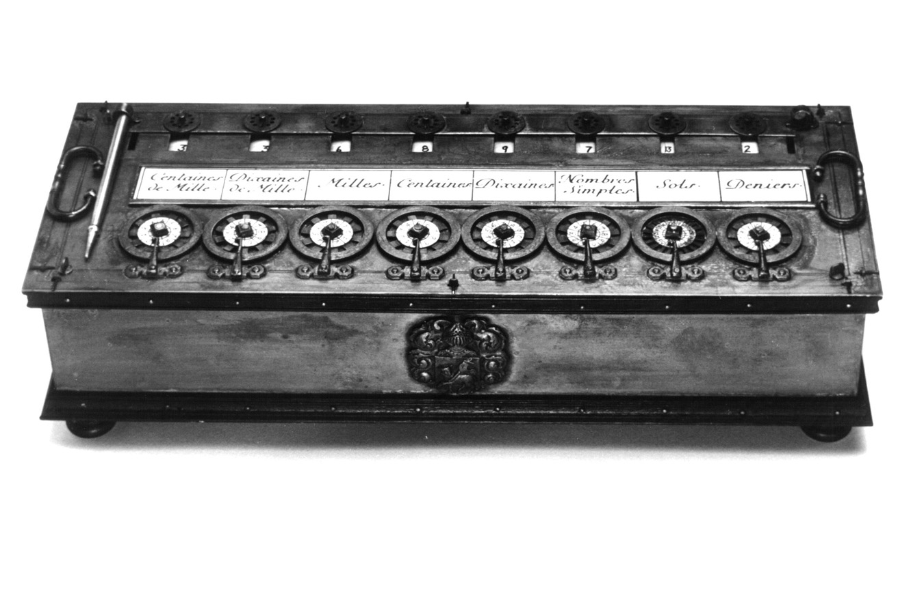
Figure 1.4
The Pascaline: One of the Earliest Mechanical Calculators
Invitation to Computer Science, C++ Version, Fourth Edition
Notes:
The model of this early calculation device is shown in figure.

Slide 18
The Early Period: Up to 1940 (continued)
1801: The Jacquard loom
  Developed by Joseph Jacquard
  Automated loom
  Used punched cards to create desired pattern
1823: The Difference Engine
  Developed by Charles Babbage
  Did addition, subtraction, multiplication, and division to 6 significant digits
  Solved polynomial equations and other complex mathematical problems
Invitation to Computer Science, C++ Version, Fourth Edition
Notes:
Loom: dokuma tezgahı
Surpisingly, the first actual computing device was not created for the purpose of mathematical computations.
He designed a automated loom that used punched cards.
This represnted an enourmously importand stage in the development of computers.

Slide 19
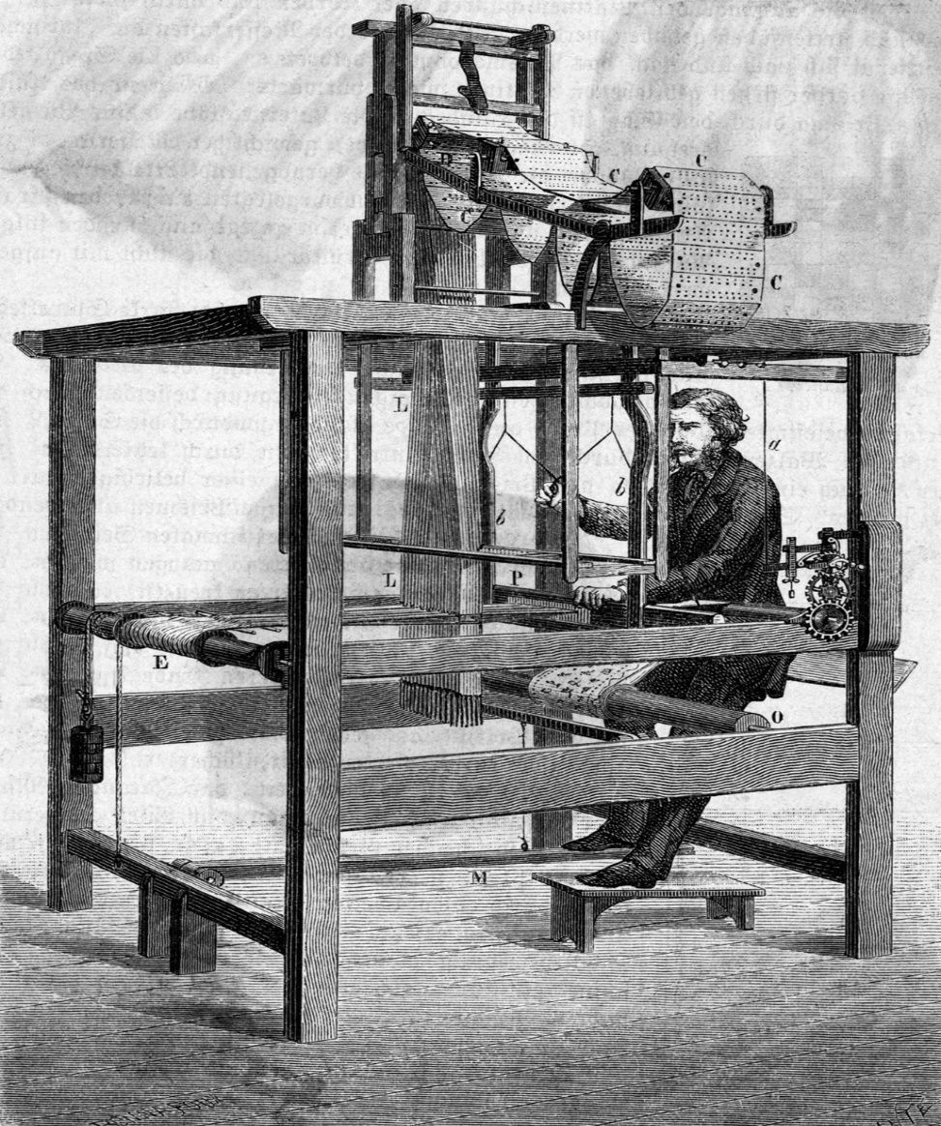
Figure 1.5
Drawing of the Jacquard Loom
Invitation to Computer Science, C++ Version, Fourth Edition
Notes:
Each punched card described one row of the pattern. Jacquard connected the cards and fed them through his loom and he automatically sequenced from card to card, weaving the desired pattern.
It was the first proggrammable device and also showed that how the knowledge of human expert couuld be captured in human-readable form.

Slide 20
The Early Period: Up to 1940 (continued)
1830s: The Analytic Engine
  Designed by Charles Babbage
  More powerful and general-purpose computational machine
  Components were functionally similar to the four major components of today’s computers
    Mill (modern terminology: arithmetic/logic unit)
    Store (modern terminology: memory)
    Operator (modern terminology: processor)
    Output (modern terminology: input/output)
Invitation to Computer Science, C++ Version, Fourth Edition
Notes:
His machine had four basic components
Mill to perform arithmetic manipulation of data
Store to hold the data
Operator to process intructions contained on punched cards
And an output unit to put results on separate punched cards.

Slide 21
The Early Period: Up to 1940 (continued)
1890: U.S. census carried out with programmable card processing machines
  Built by Herman Hollerith
  These machines could automatically read, tally, and sort data entered on punched cards
Invitation to Computer Science, C++ Version, Fourth Edition
Notes:
Tally hesapllama

Slide 22
The Birth of Computers:
1940-1950
Development of electronic, general-purpose computers
  Did not begin until after 1940
  Was fueled in large part by needs of World War II
Early computers
  Mark I
  ENIAC
  ABC system
  Colossus
  Z1
Invitation to Computer Science, C++ Version, Fourth Edition
Notes:
MARK I and ENIAC are two well known examples of early computers
Colossus was taking from in England, Z1 in Germany.
Although these had memory and programmable, they did not look like modern computer systems.

Slide 23
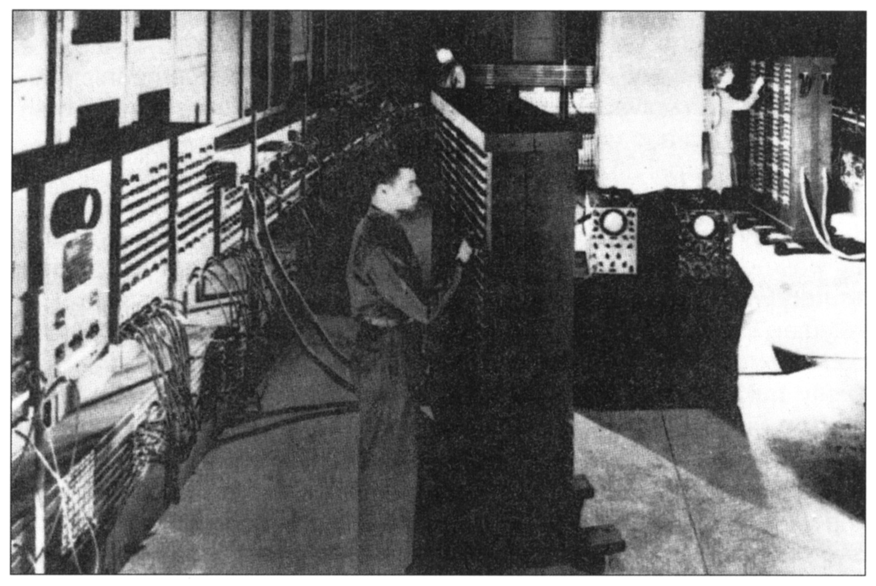
Figure 1.6
Photograph of the ENIAC Computer
Invitation to Computer Science, C++ Version, Fourth Edition
Notes:
ENIAC containe 18.000 vacuum tubes and nearly filled a building.

Slide 24
The Birth of Computers:
1940-1950 (continued)
Stored program computer model
  Proposed by John Von Neumann in 1946
  Stored binary algorithm in the computer’s memory along with the data
  Is known as the Von Neumann architecture
  Modern computers remain, fundamentally, Von Neumann machines
  First stored program computers
    EDVAC
    EDSAC
Invitation to Computer Science, C++ Version, Fourth Edition
Notes:
Von neuman proposed a different computer design based on a model called the stored program computer.
Until then, all computers were programmed externally using wires and connectors. The memory unit stored only data not instructions.
Instructions that control the operation of the computer be encoded as binaary values and stored internally in the memory unit along with the data.
To solve a new problem, instead of rewiring the machine, you would rewrite the sequence of instructions, thus he invented the programming.

Slide 25
The Modern Era: 1950 to the Present
First generation of computing (1950-1957)
  Vacuum tubes used to store data and programs
  Each computer was multiple rooms in size
  Computers were not very reliable
Invitation to Computer Science, C++ Version, Fourth Edition

Slide 26
The Modern Era: 1950 to the Present (continued)
Second generation of computing (1957-1965)
  Transistors and magnetic cores replaced vacuum tubes
  Dramatic reduction in size
    Computer could fit into a single room
  Increase in reliability of computers
  Reduced cost of computers
  High-level programming languages
    The programmer occupation was born
Invitation to Computer Science, C++ Version, Fourth Edition

Slide 27
The Modern Era: 1950 to the Present (continued)
Third generation of computing (1965-1975)
  Integrated circuits rather than individual electronic components were used
  Further reduction in size and cost of computers
    Computers became desk-sized
    First minicomputer developed
  Software industry formed
Invitation to Computer Science, C++ Version, Fourth Edition

Slide 28
The Modern Era: 1950 to the Present (continued)
Fourth generation of computing (1975-1985)
  Reduced to the size of a typewriter
  First microcomputer developed
  Desktop and personal computers common
  Appearance of
    Computer networks
    Electronic mail
    User-friendly systems (graphical user interfaces)
    Embedded systems
Invitation to Computer Science, C++ Version, Fourth Edition

Slide 29
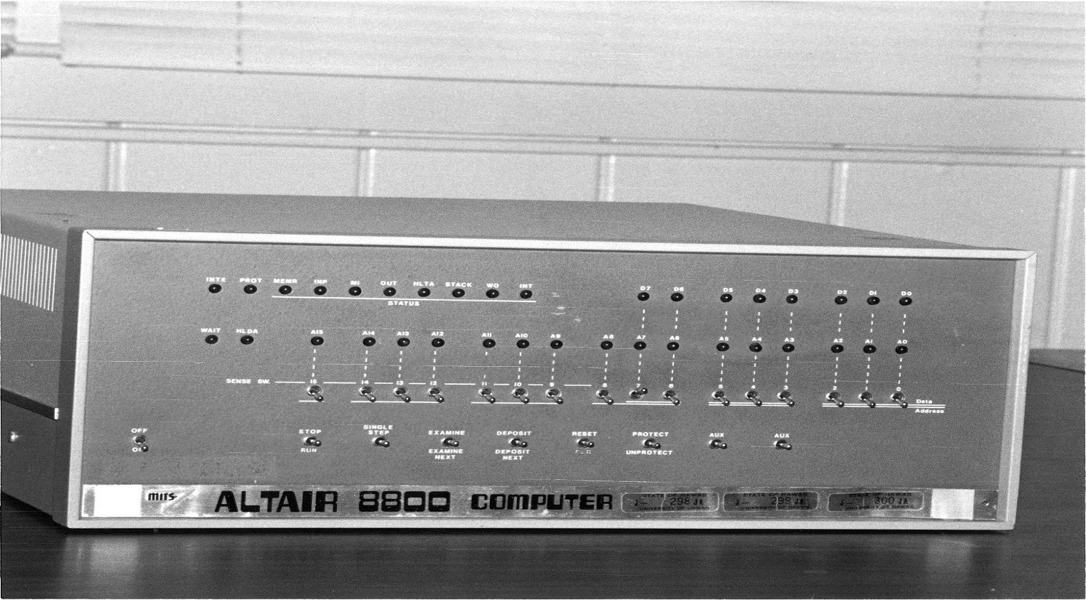
Figure 1.7
The Altair 8800, the World’s First Microcomputer
Invitation to Computer Science, C++ Version, Fourth Edition

Slide 30
The Modern Era: 1950 to the Present (continued)
Fifth generation of computing (1985-?)
  Recent developments
    Massively parallel processors
    Handheld devices and other types of personal digital assistants (PDAs)
    High-resolution graphics
    Powerful multimedia user interfaces incorporating sound, voice recognition, touch, photography, video, and television
Invitation to Computer Science, C++ Version, Fourth Edition

Slide 31
The Modern Era: 1950 to the Present (continued)
Recent developments (continued)
  Integrated global telecommunications incorporating data, television, telephone, fax, the Internet, and the World Wide Web
  Wireless data communications
  Massive storage devices
  Ubiquitous computing
Invitation to Computer Science, C++ Version, Fourth Edition

Slide 32
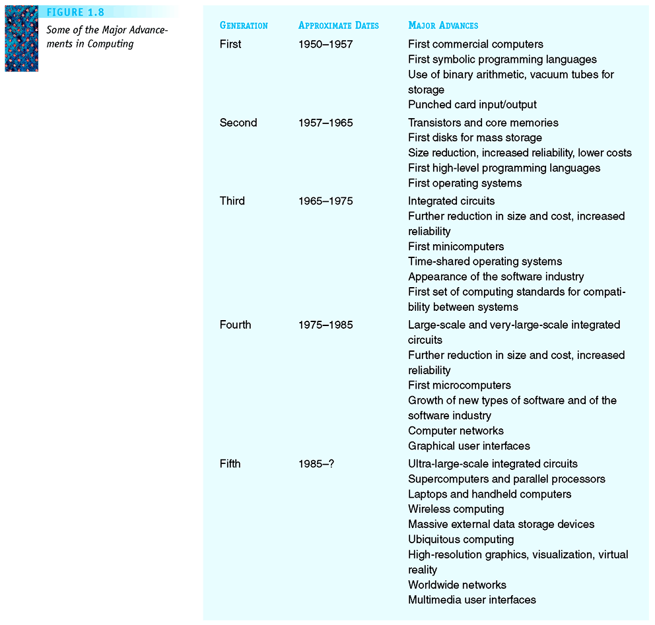
Figure 1.8
Some of the Major Advancements in Computing
Invitation to Computer Science, C++ Version, Fourth Edition

Slide 33
Figure 1.8
Some of the Major Advancements in Computing
Invitation to Computer Science, C++ Version, Fourth Edition

Slide 34
Summary
Computer science is the study of algorithms
An algorithm is a well-ordered collection of unambiguous and effectively computable operations that, when executed, produces a result and halts in a finite amount of time
If we can specify an algorithm to solve a problem, then we can automate its solution
Computers developed from mechanical calculating devices to modern electronic marvels of miniaturization
Invitation to Computer Science, C++ Version, Fourth Edition

